Slide 1
Unit 3
EXPONENTIAL SMOOTHING METHODS

Slide 2
Introduction
What is Exponential smoothing?
Exponential smoothing methods are a family of forecasting techniques used to predict results.
Useful in time series analysis for their simplicity and effectiveness in handling data with trends and seasonality.
The key idea behind exponential smoothing is to give more weight to recent observations while gradually reducing the influence of older observations.
This makes these methods responsive to changes in the data over time future values based on past data.

Slide 3
Types of exponential smoothing
1. Simple Exponential Smoothing
Simple exponential smoothing (SES), also known as single exponential smoothing, is the simplest form of exponential smoothing. It assumes that the time series has no trend or seasonality.
The forecast for the next period is based on the weighted average of the previous observation and the forecast for the current period.

Slide 4
Types of exponential smoothing
The smoothing parameter α controls the weight given to the current observation and the previous forecast.
A high value of α gives more weight to the current observation, while a low value of α gives more weight to the previous forecast.
1. Simple Exponential Smoothing
The formula for simple exponential smoothing is:
s_{(t)} = αx_{(t)} + (1-α)s_{t-1}
where
s_{(t)} is the smoothed value at time t,
x_{(t)} is the observed value at time t,
s_{t-1} is the previous smoothed statistic, and
α is the smoothing parameter between 0 and 1.

Slide 5
To apply Simple Exponential Smoothing in R, you can use the HoltWinters function, which is part of the base stats package, or you can use the forecast package.
Using the HoltWinters Function The HoltWinters function can be used for simple exponential smoothing by setting the beta and gamma parameters to FALSE, effectively turning off trend and seasonal components.

Slide 6
Here’s how you can apply Simple Exponential Smoothing using HoltWinters:
Install and Load the Required Packages
If you don’t already have the forecast package installed, you can install it using:
install.packages("forecast")
Load the forecast package:
library(forecast)
Load Your Data
For demonstration purposes, let’s use the built-in AirPassengers dataset:
data("AirPassengers") ap_data <- AirPassengers
This dataset contains monthly totals of international airline passengers from 1949 to 1960.

Slide 7
Apply Simple Exponential Smoothing
Use the HoltWinters function with beta and gamma set to FALSE:
# Apply Simple Exponential Smoothing ses_model <- HoltWinters(ap_data, beta = FALSE, gamma = FALSE) # Print the model summary print(ses_model)
Forecast Future Values
To forecast future values, use the forecast function from the forecast package:
# Forecast the next 12 months forecast_ses <- forecast(ses_model, h = 12) # Plot the forecast plot(forecast_ses)

Slide 8
Using the forecast Package Directly
Example
# Load the forecast package
library(forecast)
# Load the AirPassengers dataset
data("AirPassengers")
ap_data <- AirPassengers
# Apply Simple Exponential Smoothing using the forecast package
ses_model <- ses(ap_data, h = 12)
# Print the model summary
print(ses_model)
# Plot the forecast
plot(ses_model)

Slide 9
2. Holt’s linear exponential smoothing
Holt’s linear exponential smoothing, also known as double exponential smoothing, is used to forecast time series data that has a linear trend but no seasonal pattern.
This method uses two smoothing parameters: α for the level (the intercept) and β for the trend.
The formulas for double exponential smoothing are:
s_{t} = αx_{t} + (1 – α)(s_{t-1} + b_{t-1})
β_{t} = β(s_{t} – s_{t-1}) + (1 – β)b_{t-1}
where
bt is the slope and best estimate of the trend at time t,
α is the smoothing parameter of data (0 < α < 1), and
β is the smoothing parameter for the trend (0 < β < 1).

Slide 10
3. Holt-Winters’ exponential smoothing
Holt-Winters’ exponential smoothing, also referred to as triple exponential smoothing, is used to forecast time series data that has both a trend and a seasonal component.
It uses three smoothing parameters: α for the level (the intercept), β for the trend, and γ for the seasonal component.

Slide 11
When to use exponential smoothing
Here are some other common situations where exponential smoothing can be useful:
Time series forecasting — One of the most common applications of exponential smoothing is in time series forecasting. If you have historical data for a particular variable over time, such as sales or website traffic, you can use exponential smoothing to forecast the future values of that variable.
Inventory management — Exponential smoothing can be used to forecast demand for products or services, which can be helpful in inventory management. By forecasting demand, businesses can make sure they have enough inventory on hand to meet customer needs without overstocking, which can be expensive.
Notes:
https://www.influxdata.com/blog/exponential-smoothing-beginners-guide/#:~:text=Exponential%20smoothing%20is%20a%20time,changing%20trends%20in%20the%20data.

Slide 12
When to use exponential smoothing
Here are some other common situations where exponential smoothing can be useful:
Finance — It can be used in finance to forecast stock prices, interest rates, and other financial variables. This can be helpful for investors who are trying to make informed decisions about buying and selling stocks or other financial instruments.
Marketing — It’s also used to forecast the effectiveness of marketing campaigns. By tracking the results of past campaigns and using exponential smoothing to forecast future performance, marketers can optimize their campaigns to achieve the best possible results.
Notes:
https://www.influxdata.com/blog/exponential-smoothing-beginners-guide/#:~:text=Exponential%20smoothing%20is%20a%20time,changing%20trends%20in%20the%20data.

Slide 13
First-Order Exponential Smoothing
First-Order Exponential Smoothing, often just referred to as Exponential Smoothing, is a technique used to smooth time series data by weighting recent observations more heavily than older ones.
It is called "first-order" because it involves smoothing with a single smoothing parameter, making it a relatively simple yet effective method for forecasting.

Slide 14
First-Order Exponential Smoothing
Key Concepts
Smoothing Constant (α): This parameter controls the weighting of the most recent observation. The value of α ranges between 0 and 1. A higher α gives more weight to recent observations, making the model more responsive to changes in the data.
Forecast Equation: The forecast for the next period is a weighted average of the most recent observation and the previous forecast.
Actual Observation (yt​): The actual value observed at time ttt.
Previous Forecast (y^​t​): The forecasted value for the current time period.

Slide 15
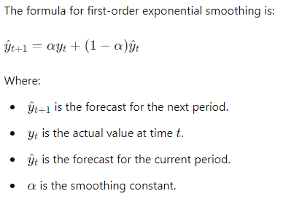
Formula
The forecasting formula for first-order exponential smoothing is:

Slide 16
Characteristics
Simple: It’s easy to compute and understand.
Adaptive: It reacts quickly to changes in the data if α\alpha is set high.
Limited: It assumes a constant level in the data without accounting for trends or seasonal variations. For more complex patterns, other methods like Holt’s linear trend model or Holt-Winters seasonal model might be more appropriate.

Slide 17
Implementation in R
Here’s how you can implement First-Order Exponential Smoothing in R using a ses function and the forecast package:
Explanation
forecast Package: The ses function from the forecast package simplifies the process, automatically handling the smoothing and forecasting.
# Load the forecast package
library(forecast)
# Load the AirPassengers dataset
data("AirPassengers")
ap_data <- AirPassengers
# Apply Simple Exponential Smoothing
ses_model <- ses(ap_data, alpha = 0.2, h = 12) # Example smoothing constant and forecast horizon
# Print the model summary
print(ses_model)
# Plot the forecast
plot(ses_model)

Slide 18
Modelling Time Series
Modeling time series data involves techniques and methods to understand and forecast data points collected or recorded at specific time intervals.
1. Understanding Time Series Data
Time Series Data: Data points collected at successive, evenly spaced intervals of time. Examples include monthly sales data, daily temperature readings, and quarterly economic indicators.

Slide 19
Modelling Time Series
Components of Time Series Data:
Trend: The long-term movement in the data.
Seasonality: Repeated patterns or cycles at fixed intervals (e.g., monthly, yearly).
Cyclic Patterns: Long-term fluctuations not fixed in period (e.g., economic cycles).
Irregular Components: Random or unpredictable fluctuations.

Slide 20
2. Preprocessing Time Series Data
Preprocessing Time Series Data
Visualize the Data: Plot the time series to identify trends, seasonality, and anomalies.
Handle Missing Values: Fill or interpolate missing values as needed.
Check for Stationarity: Time series data should ideally be stationary (constant mean and variance over time). Use methods like the Augmented Dickey-Fuller test to check for stationarity.
Transform the Data: Apply transformations like logarithms or differencing to stabilize variance and make the data stationary.

Slide 21
3. Modeling Techniques
3. Modeling Techniques
3.1. Descriptive Methods
Moving Averages: Smooth data to identify trends by averaging data points within a window.
Simple Moving Average (SMA): Unweighted average.
Weighted Moving Average (WMA): Assigns different weights to data points.
Exponential Smoothing: Gives more weight to recent observations.
Simple Exponential Smoothing: For stationary data.
Holt’s Linear Trend Model: For data with a trend.
Holt-Winters Seasonal Model: For data with trend and seasonality.

Slide 22
3.2. Statistical Methods
ARIMA (Autoregressive Integrated Moving Average): Combines autoregressive (AR) terms, differencing (I), and moving average (MA) terms.
AR Component: Uses past values.
I Component: Differencing to achieve stationarity.
MA Component: Uses past forecast errors.
SARIMA (Seasonal ARIMA): Extends ARIMA to handle seasonality by including seasonal terms.
ARCH/GARCH (Autoregressive Conditional Heteroskedasticity/Generalized ARCH): Models for time series with changing variance over time, useful for financial data volatility.

Slide 23
3.3. State Space Models and Filtering
State Space Models: Represent the time series as a system with hidden states and observable outputs.
Kalman Filter: An algorithm for estimating the hidden states in dynamic systems.

Slide 24
3.4. Machine Learning Approaches
Regression Trees and Random Forests: Can capture non-linear relationships and interactions in time series data.
Support Vector Machines (SVM): Adapted for time series forecasting tasks.
Neural Networks:
Recurrent Neural Networks (RNNs): Suitable for sequential data.
Long Short-Term Memory (LSTM) Networks: Handle long-term dependencies and trends in time series data.
Transformers: Advanced models for capturing complex temporal patterns.

Slide 25
3.5. Specialized Models
Prophet: Developed by Facebook for forecasting time series data, it handles seasonality, trend changes, and missing data effectively.

Slide 26
4. Model Evaluation
4. Model Evaluation
Split Data: Use training and test datasets to validate model performance.
Residual Analysis: Examine residuals to ensure they are random and not patterned.
Performance Metrics:
Mean Absolute Error (MAE): Average of absolute errors.
Mean Squared Error (MSE): Average of squared errors.
Root Mean Squared Error (RMSE): Square root of MSE.
Mean Absolute Percentage Error (MAPE): Average percentage error.

Slide 27
Example Workflow in R
# Fit ARIMA model
fit <- auto.arima(ts_data)
forecasts <- forecast(fit, h = 12)
autoplot(forecasts)
# Fit Exponential Smoothing model
fit_es <- ets(ts_data)
forecasts_es <- forecast(fit_es, h = 12)
autoplot(forecasts_es)
# Fit Prophet model
df <- data.frame(ds = as.Date(data$Date), y = data$Value)
model <- prophet(df)
future <- make_future_dataframe(model, periods = 12, freq = 'month')
forecast <- predict(model, future)
plot(model, forecast)
# Load libraries
library(ggplot2)
library(forecast)
library(tseries)
library(prophet)
# Load and prepare data
data <- read_csv("your_timeseries_data.csv")
ts_data <- ts(data$Value, start = c(2020, 1), frequency = 12)
# Plot the data
autoplot(ts_data) + ggtitle("Time Series Plot")
# Decompose the series
decomp <- stl(ts_data, s.window = "periodic")
autoplot(decomp)
# Check stationarity
adf.test(ts_data)

Slide 28
SECOND-ORDER EXPONENTIAL SMOOTHING
Second-order exponential smoothing, also known as Holt’s linear trend model, extends simple exponential smoothing to account for data with a trend component.
Key Concepts
Level Component: The smoothed value that represents the current level of the time series.
Trend Component: The smoothed estimate of the trend (slope) in the time series.
Formula
Second-order exponential smoothing involves two smoothing equations:

Slide 29
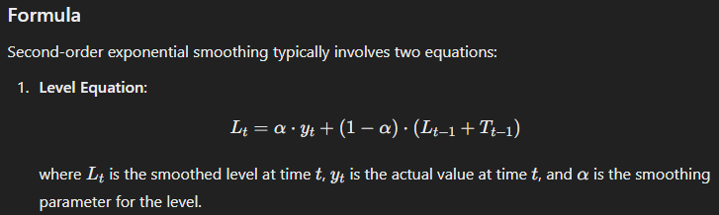
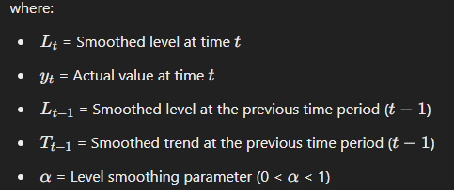

Slide 30
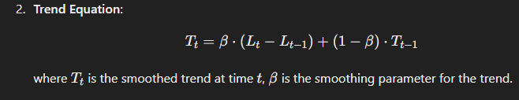
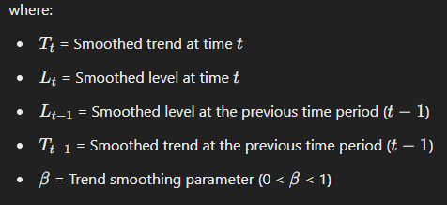

Slide 31
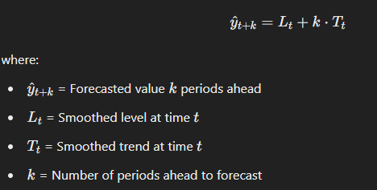
Forecasting
To forecast future values, the model uses the updated level and trend estimates. For a forecast k periods ahead, the formula is:

Slide 32
Choosing Parameters
α\alphaα (Level Smoothing Parameter): Controls the weight given to the most recent observation versus the smoothed level.
β\betaβ (Trend Smoothing Parameter): Controls the weight given to the most recent trend estimate versus the smoothed trend.
Practical Use
Second-order exponential smoothing is particularly useful when your data shows a trend that changes over time. For example, it can handle situations where the rate of increase or decrease is not constant.

Slide 33
Applications
Economics: Forecasting economic indicators with changing trends.
Sales: Predicting future sales when growth rates vary.
Finance: Modeling stock prices or other financial data with dynamic trends

Slide 34
Implementation in R
# Forecast the next 12 periods
forecasts_holt <- forecast(fit_holt, h = 12)
# Plot the forecasts
autoplot(forecasts_holt) + ggtitle("Holt's Linear Trend Model Forecast") + xlab("Time") + ylab("Value")
# Install and load the necessary package
install.packages("forecast")
library(forecast)
# Load or create your time series data
# For example, create a simple time series
ts_data <- ts(c(120, 130, 125, 140, 150, 160, 165, 170, 180, 190, 200), frequency = 12, start = c(2020, 1))
# Fit Holt's Linear Trend Model
fit_holt <- holt(ts_data)
# Print model summary
summary(fit_holt)

Slide 35
Higher-order exponential smoothing
Higher-order exponential smoothing extends the concepts of simple and second-order exponential smoothing to accommodate more complex time series patterns, such as those with changing trends or cycles.
These methods are designed to better capture intricate behaviors in the data, including nonlinear trends or seasonality.

Slide 36
1. Types of Higher-Order Exponential Smoothing
1.1. Holt’s Linear Trend Model (Second-Order Exponential Smoothing)
Holt’s model extends simple exponential smoothing to handle linear trends. It includes:
Level Component: Captures the smoothed value.
Trend Component: Captures the trend in the data.

Slide 37
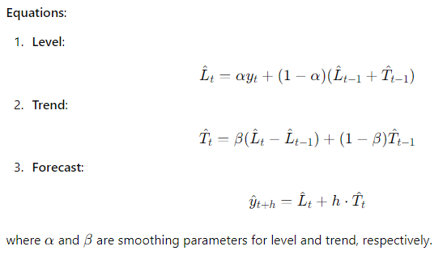

Slide 38
1.2. Holt-Winters Seasonal Model (Third-Order Exponential Smoothing)
This model accounts for both trends and seasonality and can be:
Additive Seasonal Model: Suitable for data with seasonal fluctuations of constant magnitude.
Multiplicative Seasonal Model: Suitable for data with seasonal fluctuations that change proportionally with the level of the series.

Slide 39
Higher-Order Extensions
Fourth-Order Exponential Smoothing: Adds a fourth component to model higher-order changes (e.g., acceleration of curvature). This can get increasingly complex and is often applied when there's a need to model very complex patterns.
Seasonal Exponential Smoothing: When dealing with seasonality, higher-order smoothing methods can incorporate seasonal components to adjust for periodic patterns.

Slide 40
Higher-Order Extensions
Applications
Higher-order exponential smoothing methods are useful in scenarios where:
The trend is not linear or exhibits acceleration/deceleration.
There is a need to model complex patterns in time series data.
The data exhibits significant curvature or non-linearity.

Slide 41
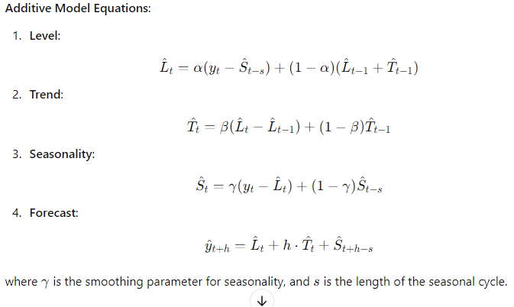

Slide 42
Implementation in R
Holt’s Linear Trend Model
# Install and load the necessary package
install.packages("forecast")
library(forecast)
# Create or load time series data
ts_data <- ts(c(120, 130, 125, 140, 150, 160, 165, 170, 180, 190, 200), frequency = 12, start = c(2020, 1))
# Fit Holt's Linear Trend Model
fit_holt <- holt(ts_data)
# Print model summary
summary(fit_holt)
# Forecast the next 12 periods
forecasts_holt <- forecast(fit_holt, h = 12)
# Plot the forecasts
library(ggplot2)
autoplot(forecasts_holt) + ggtitle("Holt's Linear Trend Model Forecast") + xlab("Time") + ylab("Value")

Slide 43
Holt-Winters Seasonal Model
# Create or load time series data
ts_data <- ts(c(120, 130, 125, 140, 150, 160, 165, 170, 180, 190, 200, 210), frequency = 12, start = c(2020, 1))
# Fit Holt-Winters Seasonal Model (Additive)
fit_hw_additive <- hw(ts_data, seasonal = "additive")
# Print model summary
summary(fit_hw_additive)
# Forecast the next 12 periods
forecasts_hw_additive <- forecast(fit_hw_additive, h = 12)
# Plot the forecasts
autoplot(forecasts_hw_additive) + ggtitle("Holt-Winters Additive Seasonal Model Forecast") + xlab("Time") + ylab("Value")

Slide 44
Exponential Smoothing Methods for Time Series Forecasting
What Are Exponential Smoothing Methods?
Exponential Smoothing Methods are a family of forecasting models. They use weighted averages of past observations to forecast new values. The idea is to give more importance to recent values in the series.
Exponential Smoothing Methods combine Error, Trend, and Seasonal components in a smoothing calculation. Each term can be combined either additively, multiplicatively, or be left out of the model. These three terms (Error, Trend, and Season) are referred to as ETS.

Slide 45
Exponential Smoothing Methods can be defined in terms of an ETS framework, in which the components are calculated in a smoothing fashion.
As we can see, combining Error, Trend, and Season in at least three different ways gives us a lot of combinations. Let’s consider some examples.

Slide 46
Using the taxonomy described at Forecasting: Principal and Practice, the three main components can be defined as:
Error: E
Trend: T
Season: S
Moreover, each term can be used in the following ways:
Additive: A
Multiplicative: M
None: N (Not included)

Slide 47
Following the same reasoning, we have:
ETS(M,N,N): Simple exponential smoothing with multiplicative errors.
ETS(A,A,N): Holt’s linear method with additive errors.
ETS(M,A,N): Holt’s linear method with multiplicative errors.

Slide 48
Time Series Decomposition Plot
Analyzing whether time series components exhibit additive or multiplicative behavior rests in the ability to identify patterns like trend, season, and error.
The trend indicates the general behavior of the time series. It represents the long-term pattern of the data — its tendency.
The seasonal component displays the variations related to calendar events. Lastly, the error component explains what the season and trend components do not. The error is the difference between the original data and the combination of trend and seasonality. Thus, if we combine all three components, we get the original data back.

Slide 49
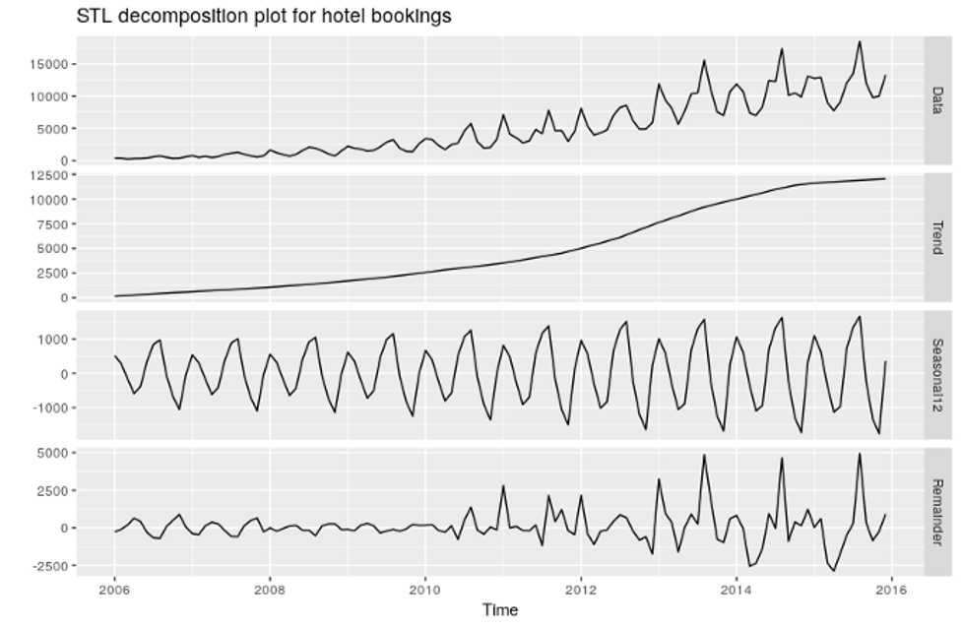

Slide 50
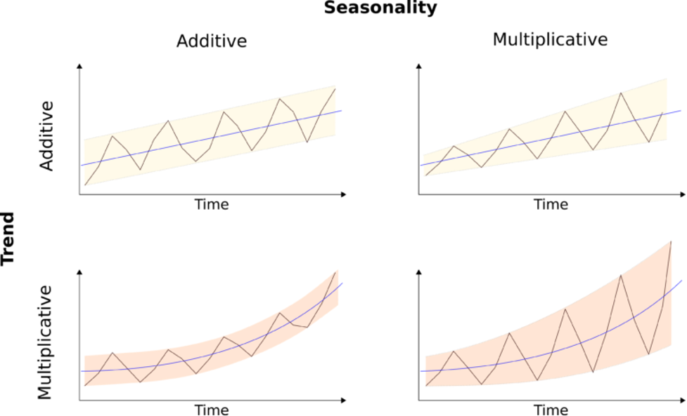
Time Series Decomposition Analysis
Notes:
https://www.encora.com/insights/exponential-smoothing-methods-for-time-series-forecasting

Slide 51
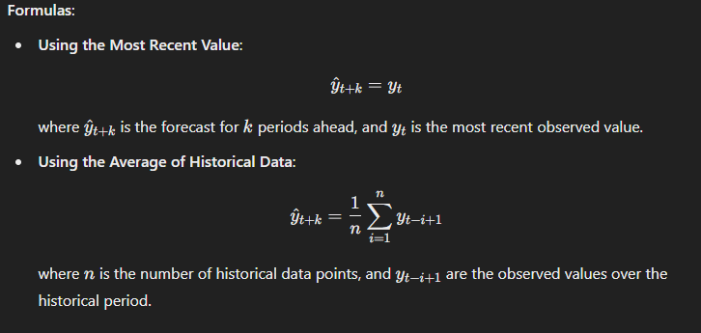
Forecasting a Constant Process
For a constant process, the forecasting approach is straightforward because there are no trends or seasonal patterns to account for. Here’s how you can handle forecasting in this scenario:

Slide 52
Characteristics of a Constant Process
No Trend: The data does not show an upward or downward trend over time.
No Seasonality: The data does not exhibit periodic fluctuations.
Stability: The values are stable and do not vary significantly from one period to the next.

Slide 53
Practical Considerations
Data Validation: Ensure that the series truly lacks trend and seasonality before applying these methods. If there are underlying trends or seasonal patterns, more sophisticated models may be necessary.
Model Simplicity: For constant processes, simpler models are usually sufficient. More complex methods may not provide additional benefits and could unnecessarily complicate the forecasting process.

Slide 54
Linear trend Process
Choosing the Right Method
Simple Linear Regression: Suitable for straightforward linear trends with no additional components like seasonality.
Holt’s Linear Trend Method: Useful when you need to handle smoothing and have irregular data.
State Space Models: Offers flexibility and can be used when more complex modeling is needed.
Damped Trend Method: Best when the trend is expected to diminish over time.

Slide 55
Adaptive updating of the discount factor
Adaptive updating of the discount factor is a concept that involves adjusting the discount factor dynamically based on certain criteria or performance metrics.
What is the Discount Factor?
The discount factor, often denoted by λ\lambdaλ or α\alphaα, is a parameter used to determine the weight given to past observations relative to more recent observations.

Slide 56
Adaptive Updating of the Discount Factor
Adaptive updating refers to the practice of adjusting the discount factor based on the performance of the forecasting model or the characteristics of the time series data.

Slide 57
Methods for Adaptive Updating
1. Performance-Based Adjustment
Approach:
Adjust the discount factor based on the model's forecasting performance. For example, if recent forecasts are less accurate, you might decrease the discount factor to give more weight to recent observations.
Steps:
Monitor Forecast Accuracy: Track forecasting errors using metrics like Mean Absolute Error (MAE) or Root Mean Squared Error (RMSE).
Adjust Factor: If errors increase, adjust the discount factor to be more responsive. Conversely, if errors decrease, you might adjust the factor to stabilize the forecast.

Slide 58
Methods for Adaptive Updating
2. Data-Driven Adjustment
Approach:
Adjust the discount factor based on the statistical properties of the data, such as changes in variance or trend.
Steps:
Analyze Data: Use statistical tests or methods to detect changes in variance or trend.
Update Factor: Adjust the discount factor based on detected changes. For example, if the data exhibits increased variance, you might increase the discount factor to give more weight to recent data.

Slide 59
3. Model-Based Adjustment
Approach:
Use models or algorithms that adaptively determine the discount factor based on the time series characteristics.
Steps:
Fit Adaptive Model: Fit a model that dynamically adjusts the discount factor based on time series characteristics.
Forecast and Update: Use the model to generate forecasts and adjust the discount factor as new data becomes available.

Slide 60
Practical Considerations
Stability vs. Responsiveness: Balancing between making the model responsive to recent changes and maintaining stability is crucial. Too much adjustment can lead to overfitting, while too little adjustment can make the model slow to adapt to changes.
Parameter Tuning: Carefully tune the parameters governing the adaptive updates to achieve the desired level of responsiveness and accuracy.
Computational Complexity: Ensure that the adaptive updating mechanism does not introduce excessive computational complexity, especially in real-time applications.

Slide 61
Exponential Smoothing of Bio-surveillance
Exponential smoothing is a widely used forecasting method that can be particularly effective in bio-surveillance, which involves monitoring and predicting trends in biological and health-related data, such as disease outbreaks, infection rates, and other health indicators.
Exponential smoothing helps in making short-term forecasts based on past data, smoothing out short-term fluctuations and highlighting longer-term trends.

Slide 62
Applications of Exponential Smoothing in Bio-surveillance
Disease Outbreak Forecasting
Objective: Predict the future incidence of diseases based on historical data.
Example: Forecasting weekly or monthly cases of a contagious disease like influenza or COVID-19.
Monitoring Epidemic Trends
Objective: Track the progression of an epidemic over time and anticipate future trends.
Example: Smoothing daily case counts to identify underlying trends and assess the effectiveness of public health interventions.
Predicting Hospital Admissions
Objective: Estimate future hospital admissions based on historical data.
Example: Forecasting the number of emergency room visits or hospitalizations related to a particular illness or condition.

Slide 63
Exponential Smoothing Methods for Bio-surveillance
1. Simple Exponential Smoothing
Purpose: Useful for time series data without significant trends or seasonality.
Equation:
St​=α⋅yt​+(1−α)⋅St−1​
where:
St​ = Smoothed value at time t
yt​ = Actual value at time t (e.g., number of cases)
St−1​ = Smoothed value at the previous time period
α = Smoothing parameter (0 < α < 1)
Forecast:
y^{^t}+k=St

Slide 64
Considerations for Bio-surveillance
Seasonality: Many biological phenomena, such as flu outbreaks, exhibit seasonal patterns. Use Holt-Winters methods if seasonality is present.
Trend Detection: For diseases with rising or falling trends, Holt’s linear trend method or damped trend method can be effective.
Model Validation: Continuously validate and adjust models based on the latest data to ensure accuracy.
Real-time Forecasting: In bio-surveillance, timely updates are crucial. Implement models that can quickly adapt to new data.

Slide 65
Example: Forecasting Weekly Flu Cases -Assume we have a dataset of weekly flu cases and we want to forecast future cases using exponential smoothing.
Generating synthetic weekly flu case data.
Applying different exponential smoothing methods.
Plotting the forecasts.

Slide 66
R Script for Exponential Smoothing in Bio-surveillance
1. Install and Load Necessary Packages
2. Load the Data
install.packages("forecast")
# Generate synthetic weekly flu cases data
set.seed(123)
weeks <- 1:100
flu_cases <- 100 + 5 * weeks + rnorm(100, mean=0, sd=20)
# Create a time series object
flu_ts <- ts(flu_cases, frequency=52) # weekly data, so frequency is 52

Slide 67
3. Apply Simple Exponential Smoothing
# Apply Simple Exponential Smoothing
simple_es <- ets(flu_ts, model="ANN") # "ANN" stands for additive errors, no trend, no seasonality
# Forecast future values
simple_forecast <- forecast(simple_es, h=12) # Forecasting 12 weeks ahead
# Plot the forecast
plot(simple_forecast, main="Simple Exponential Smoothing Forecast")

Slide 68
4. Apply Holt’s Linear Trend Method
# Apply Holt’s Linear Trend Method
holt_es <- ets(flu_ts, model="AAN") # "AAN" stands for additive errors, additive trend, no seasonality
# Forecast future values
holt_forecast <- forecast(holt_es, h=12) # Forecasting 12 weeks ahead
# Plot the forecast
plot(holt_forecast, main="Holt’s Linear Trend Method Forecast")

Slide 69
5. Apply Holt-Winters Seasonal Method
# Apply Holt-Winters Seasonal Method (Additive Seasonality)
hw_es <- ets(flu_ts, model="AAA") # "AAA" stands for additive errors, additive trend, additive seasonality
# Forecast future values
hw_forecast <- forecast(hw_es, h=12) # Forecasting 12 weeks ahead
# Plot the forecast
plot(hw_forecast, main="Holt-Winters Additive Seasonal Forecast")

Slide 70
6. Apply Damped Trend Method
# Apply Damped Trend Method
damped_es <- ets(flu_ts, model="AAN", damped=TRUE) # "AAN" with damped trend
# Forecast future values
damped_forecast <- forecast(damped_es, h=12) # Forecasting 12 weeks ahead
# Plot the forecast
plot(damped_forecast, main="Damped Trend Method Forecast")

Slide 71
Summary of Results
Simple Exponential Smoothing: Suitable if the data doesn’t show significant trends or seasonality.
Holt’s Linear Trend Method: Useful if there's a linear trend in the data.
Holt-Winters Seasonal Method: Ideal for data with seasonal patterns.
Damped Trend Method: Effective if the trend is expected to stabilize.

Slide 72
EXPONENTIAL SMOOTHERS AND ARIMA MODELS Selection
1. Characteristics of Your Data
1.1. Trend and Seasonality
Exponential Smoothing:
Simple Exponential Smoothing: Best if there is no trend or seasonality.
Holt’s Linear Trend Model: Suitable if there is a linear trend but no seasonality.
Holt-Winters Seasonal Model: Ideal if there is a seasonal pattern (either additive or multiplicative).

Slide 73
ARIMA:
Non-Seasonal ARIMA: Effective if the series has a trend but no seasonal pattern.
SARIMA (Seasonal ARIMA): Necessary if the series exhibits seasonality.
1.2. Stationarity
Exponential Smoothing:
Does not require the data to be stationary. It can handle data with trends and seasonality directly.
ARIMA:
Requires the data to be stationary or transformed to be stationary. Differencing (I component) is used to achieve stationarity.

Slide 74
2. Complexity and Flexibility
2.1. Simplicity vs. Complexity
Exponential Smoothing:
Generally simpler to implement and understand.
Useful for forecasting with less complex models and when computation resources are limited.
ARIMA:
More flexible and capable of modeling complex patterns and relationships.
Requires more sophisticated parameter tuning and validation.

Slide 75
3. Forecasting Goals
3.1. Short-Term vs. Long-Term Forecasting
Exponential Smoothing:
Often preferred for short to medium-term forecasts due to its straightforward nature and efficiency.
ARIMA:
Suitable for both short and long-term forecasts, particularly when understanding underlying patterns or trends is crucial.

Slide 76
4. Model Selection Process
4.1. Exponential Smoothing Model Selection
Identify Pattern:
No Trend/Seasonality: Use Simple Exponential Smoothing.
Trend Only: Use Holt’s Linear Trend Model.
Seasonality Only: Use Holt-Winters Seasonal Model (additive or multiplicative depending on the nature of seasonality).
Parameter Tuning:
Select smoothing parameters (α, β, γ) based on criteria like minimizing the forecast error (e.g., Mean Absolute Error, Mean Squared Error).

Slide 77
4.2. ARIMA Model Selection
Check Stationarity:
Use plots and tests (e.g., Augmented Dickey-Fuller test) to assess stationarity.
Apply differencing if needed to achieve stationarity.
Identify Model Orders:
Use autocorrelation (ACF) and partial autocorrelation (PACF) plots to determine the values of p (AR order) and q (MA order).
Choose d (differencing order) based on the number of differences needed to make the series stationary.

Slide 78
Seasonal Component (if applicable):
Identify seasonal patterns and use SARIMA to include seasonal orders P, D, and Q.
Parameter Estimation and Validation:
Estimate parameters using techniques like Maximum Likelihood Estimation.
Validate the model using criteria like Akaike Information Criterion (AIC), Bayesian Information Criterion (BIC), and out-of-sample forecast accuracy.

Slide 79
Practical Tips
Start Simple: Begin with simpler models like Exponential Smoothing. If performance is unsatisfactory, move to more complex models like ARIMA.
Compare Models: Use cross-validation and error metrics to compare the performance of different models.
Visualize: Plot your data and residuals to visually inspect the fit of the models and identify any patterns not captured.
Automation: Consider automated tools like the auto.arima function in R or Python’s pmdarima package, which can help in selecting and tuning ARIMA models.

Slide 80
R Commands
1. Simple Exponential Smoothing
Using the forecast package:
# Install and load the forecast package if you haven't alreadyinstall.packages("forecast")library(forecast)
# Example time series
datats_data <- ts(c(120, 130, 140, 150, 160, 170, 180), frequency = 1)
# Apply Simple Exponential Smoothing
fit <- ets(ts_data, model = "ANN")
# "ANN" indicates additive errors, no trend, no seasonality
summary(fit)
# Forecast the next 5 periods
forecast_values <- forecast(fit, h = 5)
print(forecast_values)
plot(forecast_values)

Slide 81
2. Holt’s Linear Trend Model Using the forecast package:
# Example time series data
ts_data <- ts(c(120, 130, 140, 150, 160, 170, 180), frequency = 1)
# Apply Holt's Linear Trend Model
fit <- ets(ts_data, model = "AAN")
# "AAN" indicates additive errors, additive trend, no seasonality summary(fit)
# Forecast the next 5 periods
forecast_values <- forecast(fit, h = 5)
print(forecast_values)
plot(forecast_values)

Slide 82
3. Holt-Winters Seasonal Model Additive Seasonality:
# Example time series data with seasonality
ts_data <- ts(c(120, 130, 140, 150, 160, 170, 180, 190, 200, 210, 220, 230, 240, 250, 260, 270, 280, 290, 300, 310, 320, 330, 340, 350), frequency = 12)
# Apply Holt-Winters Seasonal Model with additive seasonality
fit <- ets(ts_data, model = "AAA")
# "AAA" indicates additive errors, additive trend, additive seasonality
summary(fit)
# Forecast the next 12 periods
forecast_values <- forecast(fit, h = 12)
print(forecast_values)
plot(forecast_values)

Slide 83
Multiplicative Seasonality:
# Apply Holt-Winters Seasonal Model with multiplicative seasonality
fit <- ets(ts_data, model = "MAM")
# "MAM" indicates multiplicative errors, additive trend, multiplicative seasonality
summary(fit)
# Forecast the next 12 periods
forecast_values <- forecast(fit, h = 12)
print(forecast_values)
plot(forecast_values)

Slide 84
4. Using the smooth Package Simple Exponential Smoothing:
# Install and load the smooth package if you haven't already
install.packages("smooth")
library(smooth)
# Example time series data
ts_data <- ts(c(120, 130, 140, 150, 160, 170, 180), frequency = 1)
# Apply Simple Exponential Smoothing
fit <- es(ts_data, model = "ANN")
# "ANN" indicates additive errors, no trend, no seasonality
summary(fit)
# Forecast the next 5 periods
forecast_values <- forecast(fit, h = 5)
print(forecast_values)
plot(forecast_values)

Slide 85
Holt’s Linear Trend Model:
# Apply Holt's Linear Trend Model
fit <- es(ts_data, model = "AAN")
# "AAN" indicates additive errors, additive trend, no seasonality
summary(fit)
# Forecast the next 5 periods
forecast_values <- forecast(fit, h = 5)
print(forecast_values)
plot(forecast_values)

Slide 86
Holt-Winters Seasonal Model:
# Example time series data with seasonality
ts_data <- ts(c(120, 130, 140, 150, 160, 170, 180, 190, 200, 210, 220, 230, 240, 250, 260, 270, 280, 290, 300, 310, 320, 330, 340, 350), frequency = 12)
# Apply Holt-Winters Seasonal Model with additive seasonality
fit <- es(ts_data, model = "AAA")
# "AAA" indicates additive errors, additive trend, additive seasonality
summary(fit)
# Forecast the next 12 periods
forecast_values <- forecast(fit, h = 12)
print(forecast_values)
plot(forecast_values)

Slide 87
Summary of Key Functions
ets() from the forecast package: Fit an exponential smoothing state space model.
forecast() from the forecast package: Produce forecasts from a fitted model.
es() from the smooth package: Fit exponential smoothing models.
plot(): Visualize time series and forecasts.

